Slide 1




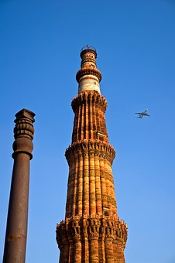
TCSへようこそ！ Welcome to TCS
Notes:
1
1

Slide 2
Customer Executives
Mr. Tomoji Tarutani - Executive Officer, IT Digital Promotion Dept, Compressor Division Sales Planning Dept, Engineering Dept.
Mr. Takenobu Watanabe - Office Manager, Assistant GM, Cyber Security Office, IT Digital Promotion Dept.
Mr. Yohei Yamamoto - Office Manager, Assistant GM, Group IT Infrastructure Office, IT Digital Promotion Dept.
TCS Japan
Mr. Taro Shibuya - CBO Delivery Head
Ms. Tomoko Wada - Client Partner
Mr. Kenji Hayakawa - Project Manager
TCS Team
Mr. Laxmikant Shaligram - Industry Leader, JDC
Ms. Priya Vernekar - Interpreter, JDC
Mr. Avinash Muley – Presales & Client visit Management, JDC
Notes:
2

Slide 3
AGENDA
22nd June 2023 (Thursday) – TCS Banyan Park - Block 4 2nd Floor VCON Room (11 Seater)
Start Time | Duration | End Time | Agenda | Presenter (s)/ Stories | Location
8:00 | 240 Mins | 12:00 | Pune to Mumbai via Road | All members
12:00 | 15 Mins | 12:15 | Reception & Security | All Members | Reception
12:15 | 65 Mins | 13:20 | Lunch |  | EDR
13:20 | 10 Mins | 13:30 | Introduction of Visit Agenda/ Context Setting | Wada | Boardroom
13:30 | 60 Mins | 14:30 | Chat GPT session | Naran/From London & Japan | Boardroom (MS Teams)
14:30 | 150 Mins | 17:00 | EBC Session GF - About TCS - 20 mins 1f and 2f - ISU stories | EBC Team | EBC
17:00 | 30 Mins | 17:30 | Wrap up & discussion for next steps | Chandrakant | Boardroom
17:30 | Depart for Dinner at 17:30 |  |  |  | Colaba
Notes:
3

Slide 4



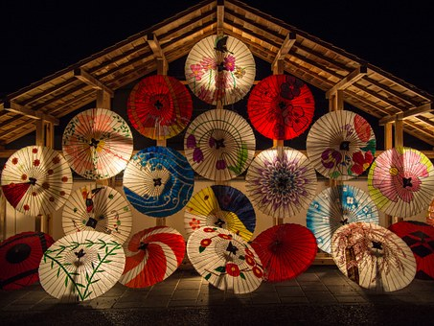


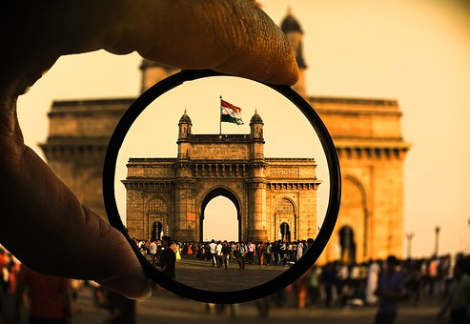
ありがとうございました

